Slide 1



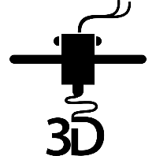

One Hands-On Tech club Two Groups
3D Printing
Small Computers

Slide 2

Welcome to H.O.T. www.handsontech.org
Our Purpose:
Forum for interaction
Many hobbyists build/tinker in isolation
Make new friends with common tech interests
Learn together
Lots of fun new tech to explore
Share expertise, help each other
Build something
Hands-On learning
Make something fun & useful

Slide 3
New to the club? Welcome!
Wondering what H.O.T. is all about?
This is a hands-on group, so we may be in the middle of a series of meetings on our way to building something interesting
Go to handsontech.org>New Members for a specially designed launching point for new members!
Please take the time to look through a few presentations at handsontech.org>Small Computers or handsontech.org>3D Printing.
Presentations are always available online after our meetings for reference and as self-paced projects

Slide 4
Club communications are via Email & Web !
To join our email list(s), fill membership form at handsontech.org>New Members
When asked for your email address, use a gmail email address if possible (we use google forums & they are picky)
You will be added automatically to our Hands-On Tech (H.O.T.) overall email list
You will also be added to the Small Computers and/or 3D Printing mailing lists and forums if you expressed interest in the membership form.
Meeting calendar is at handsontech.org

Slide 5
Home Monitoring using Cellular IoT*
Hands-on Technology – Small Computers
February 22, 2022
Bob Jessup
_______________________________________
* Internet of Things

Slide 6
The Problem – Remote Monitoring
Snowbird Concerns
Failed furnace or A/C, flooding, doors, lights
Possible Solutions
Honeywell Winter Watchman $0 / month
Wifi router, cameras, thermometers, etc. $80 / month
Security monitored services $50 / month + $80 / month
Human homewatch service $50 - $100/ month
IoT cellular sensors < $2 /month for 1 MByte

Slide 7
Cellular Solutions – Get on the Google
Hologram offers one free pilot SIM up to 1MB / month
3G Sim 800 modems w/ on board processor (obsolescent)
LillyGo ($50) includes SIM7000G & ESP32 processor
Global ($30) 1.5-inch SIM7000A (iffy sim card holder)
Botletics ($65) Arduino shield with SIM7000A modem

Slide 8
Selected Approach: Botletics & ESP32
Botletics Sim7000A Arduino shield (available tomorrow)
Hologram SIM card
Sensors to monitor 3 floors
Apply ESP32 to communicate wirelessly with sensors
____________________________________________
..besides, somebody needed a pandemic project..

Slide 9
Where We are Going:
Hologram
(Cellular)
IFTTT
Google Sheets
Google Mail
Dweet
Snow
Sun
HUB
Cellphone Widget
Home Assistant
WIFI ROUTER
Sensors
Notes:
Black path is primary path

Slide 10
Primary Path: Remote Sensor to Cellphone
Hologram
(Cellular)
IFTTT .COM
Google Mail
HUB
Cellphone Widget
WIFI ROUTER
Sensors
Notes:
Black path is primary path

Slide 11
Sensors - Hub Configuration
Sensors are wireless access point (AP) servers to pass info to HUB w/o a router.
Upstairs Bedroom (AP)
Ambient_1 192.168.4.1
Light
192.168.4.1
/temperature
Temp
Kitchen (AP)
Ambient_2 192.168.4.2
1st Floor HUB (Client)
Hum
Doors
55.3
Basement (AP)
Ambient_3 192.168.4.3
Flood

Slide 12
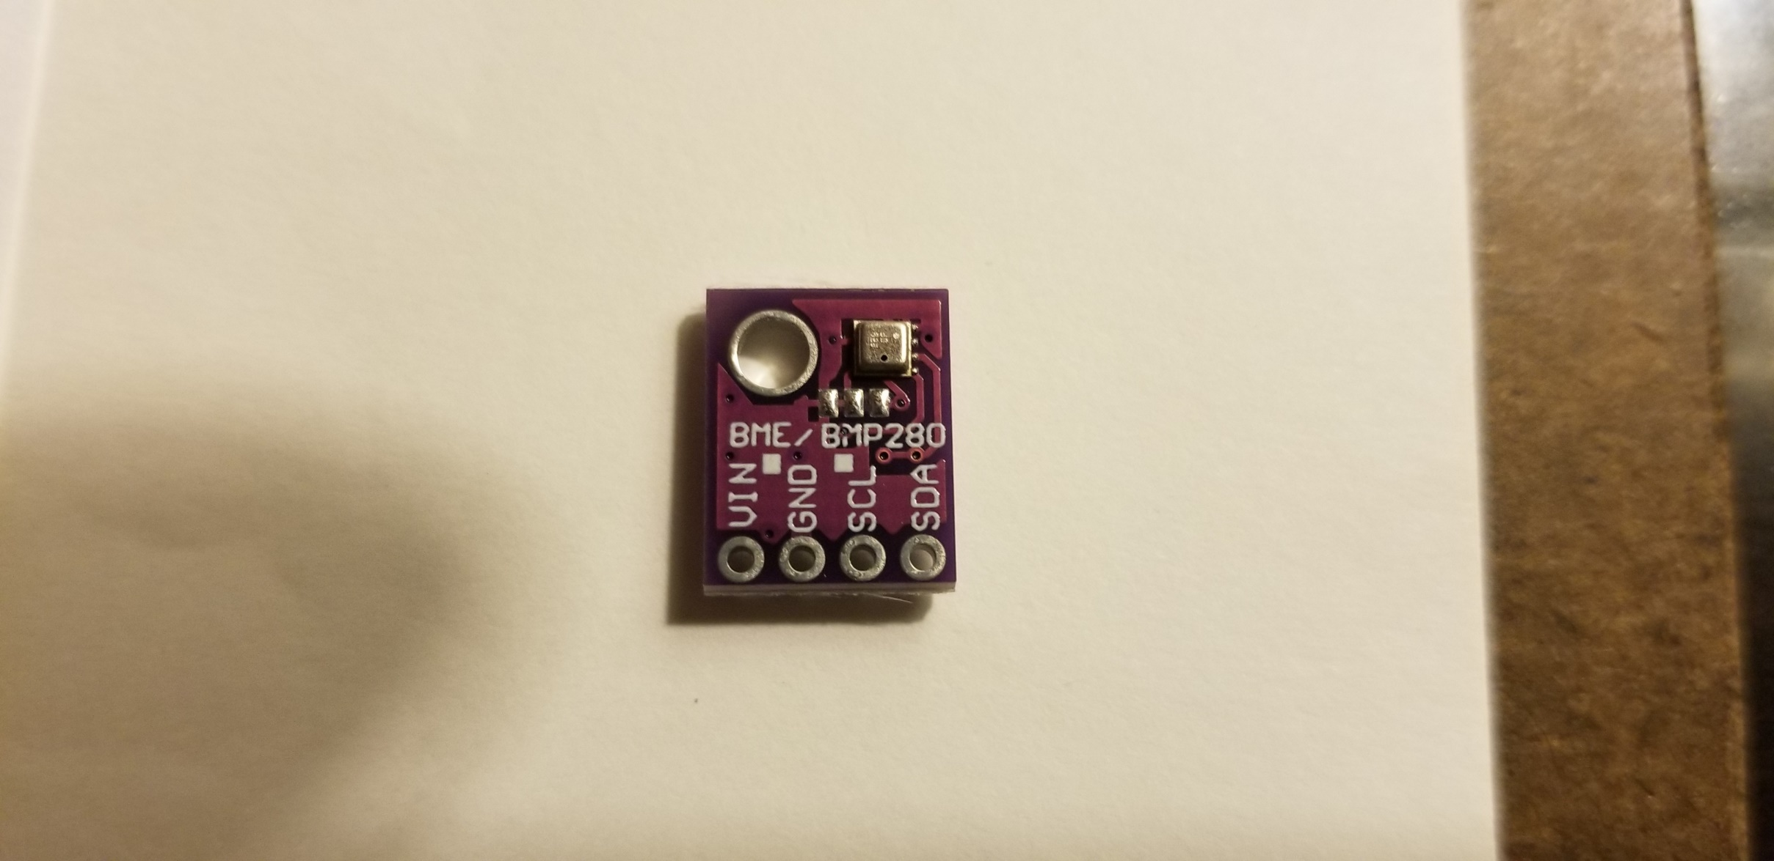
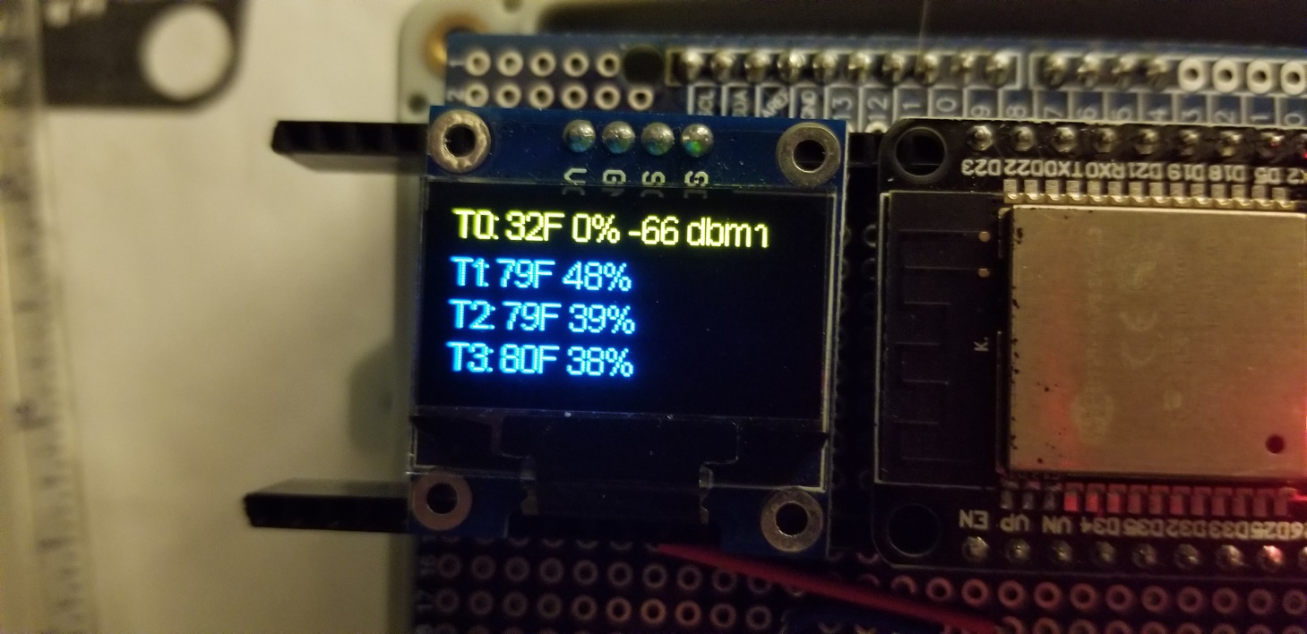
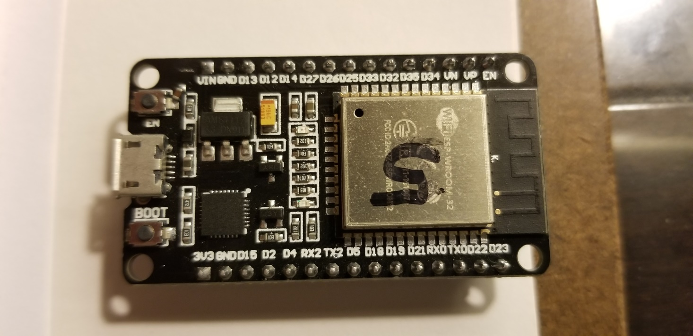
Sensor Wiring ESP32, BME280, SSD1306
Why ESP32?
Powerful $9 processor
(less $ if from China)
Wireless antenna
Strong wifi Library
Arduino based
Easy to program
Strong on-board
3.3v .8A regulator

Slide 13
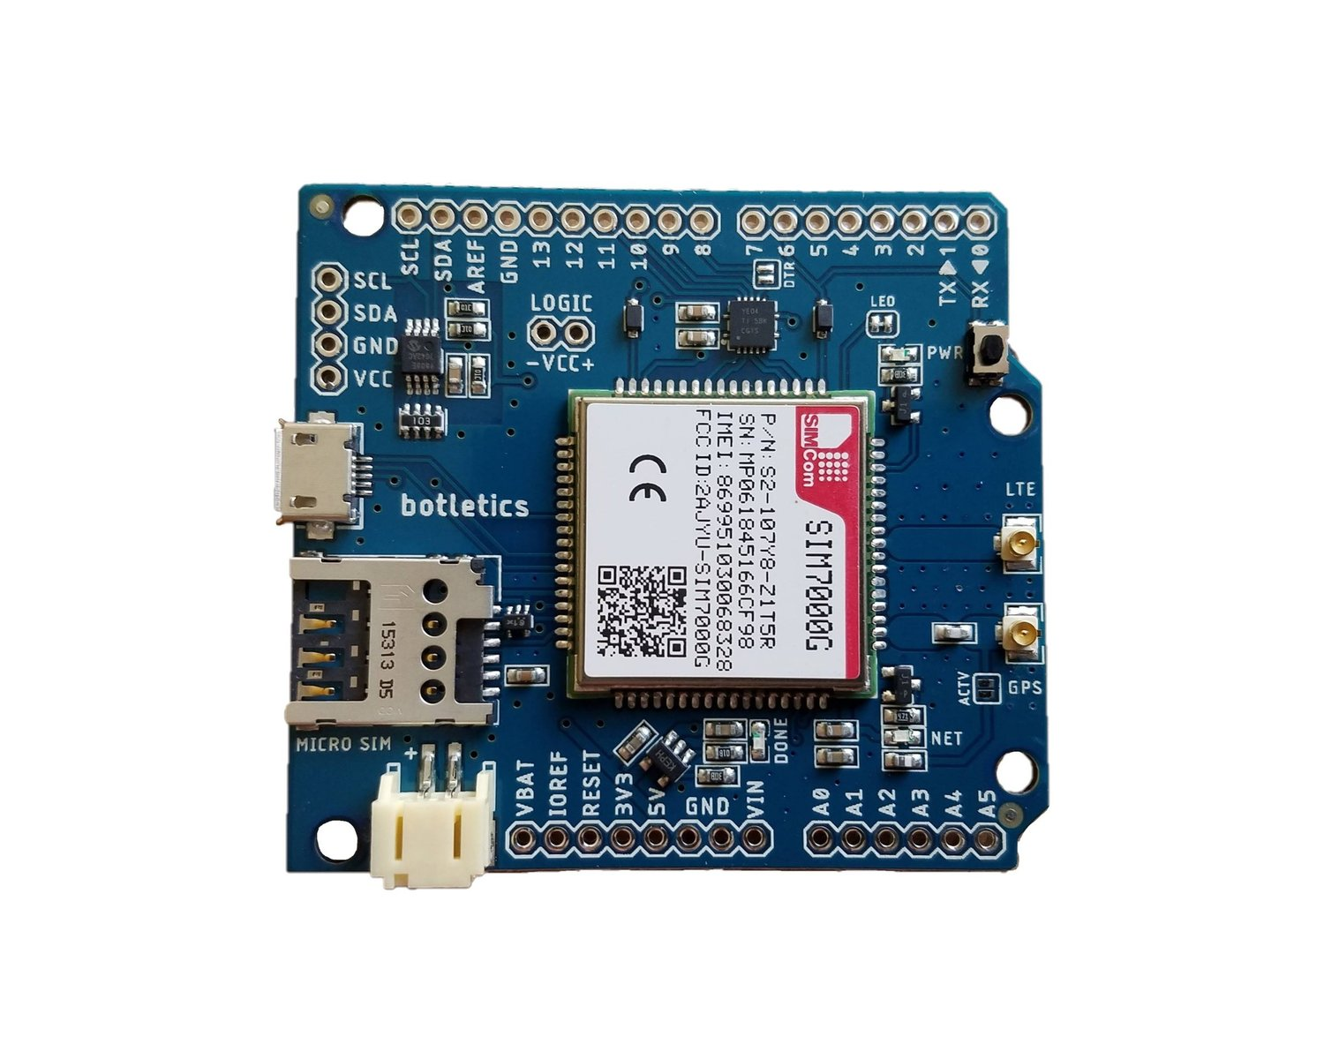
HUB Wiring: Sensor + Cellular Modem

Slide 14
Theory of Operation
Sensors are set up as wireless access point AP servers
* They return data upon receiving http GET requests
HUB is base unit (gateway) with cellular modem and processor
* It can function alone or collect sensor data using http
HUB transmits data hourly in JSON format
Messages require 1.333 kB for data and overhead.
* 1.333 kB x 24 hrs x 31 days = 992kB / month

Slide 15
JSON: Human Readable Data
JSON – JavaScript Object Notation
Simple format is {label:data,label:data}
Example: {“temperature”:”57”,”humidity”:”62”}
IFTTT allows only 3 values, but we need more
Workaround: send all our values as one:
{“Value1”:”57,57,56,58,-62,62,64,62,57”}

Slide 16
Hologram Provides Cellular Path to Cloud
Hologram
(Cellular)
IFTTT
Google Mail
HUB
Cellphone Widget
Sensors
Notes:
Black path is primary path

Slide 17
Hologram: Cellular Connectivity to the Cloud
Hologram enables connection and management of devices worldwide
Claim 470+ global cellular networks
Hologram offers free pilot ioT SIM card which includes 1MB/mo
Additional cards cost $1.50/month plus $.40 per MB
Each card includes mini (2FF), micro (3FF), Nano (4FF) size

Slide 18
IFTTT Links (Disparate) Services
Hologram
(Cellular)
IFTTT
Google Mail
HUB
Cellphone Widget
Sensors
Notes:
Black path is primary path

Slide 19
IFTTT – IF THIS Then THAT
IFTTT Links Services
IFTTT webhook event (HB) emails data and adds to Google Sheets. (IF HB THEN email data and add to Google Sheets)
IFTTT is also set up to pass weather info every 3 hours.
Use a dedicated gmail account to set up your IFTTT account.

Slide 20
Data Appears on Phone Home Screen
Hologram
(Cellular)
IFTTT
Google Mail
HUB
Cellphone Widget
Sensors
Notes:
Black path is primary path

Slide 21
Reports Appear on Phone Home Screen
The IFTTT webhook (HB) forwards data to the subject line
Set up a 2”x2” gmail widget on the home screen of your phone
Shows 2 hrs sensor data, latest weather rpt
Time, Event, 5 temps, 2 doors, 5 lights, 2 moisture, 1 SS, 4 humidity:
14:47 HB 54,55,56,58,50,0,0,00,05,03,93,00,00,-62,25,29,30,32
12:47 HB 53,54,56,56,50,0,0,00,05,03,96,00,00,-60,24,28,32,31
12:02 temp 28 AM Clouds/PM Sun today! High 32, Low 22.

Slide 22
Secondary Path – Google Sheets
Hologram
(Cellular)
IFTTT
Google Sheets
Google Mail
HUB
Cellphone Widget
Home Assistant
Sensors
Notes:
Black path is primary path

Slide 23
Secondary Path – Google Sheets
IFTTT populates the spreadsheet for system performance
DateTime, Event (HB, Weather) data are appended
IFTTT also updates the 2nd row with HB events
Home Assistant can open a card to monitor this row
Eliminates the need to track the latest inserted row

Slide 24
IF IFTTT Fails Then Dweet!!
Hologram
(Cellular)
IFTTT
Google Sheets
Google Mail
Dweet
HUB
Cellphone Widget
Home Assistant
Sensors
Notes:
Black path is primary path

Slide 25
Dweet.io Provides a Free Service
Displays the last 5 messages within past 24 hours
Use to view information if (when) IFTTT path fails
No credentials, passwords, etc.; simply make up an identifier
I use the 15 digit SIMCOM modem imei as my identifier
Retrieve at dweet.io/get/dweets/for/(your identifier)

Slide 26
Cellular IoT Home Monitor
Hologram
(Cellular)
IFTTT
Google Sheets
Google Mail
Dweet
SNOW
SUN
HUB
Cellphone Widget
Home Assistant
WIFI ROUTER
Sensors
Notes:
Black path is primary path

Slide 27
Troubleshooting Tips - Remote
Hologram, IFTTT dashboards
Dweet provides alternate report if failure occurs downstream
External timer to reboot system periodically
Run duplicate system using same software
Neighbors can read sensors directly on cellphone
Catastrophic failure – exchange units

Slide 28
To Do List – Florida
Verify Florida vendors via cellular IoT
Lawncare, bush trimming, weed & pest control
Manage sprinklers remotely
Camera to send still photos

Slide 29
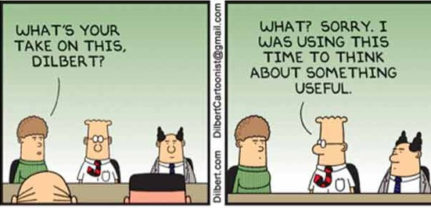

Slide 30
Hardware – A collection of all the parts you can physically Touch

Slide 31
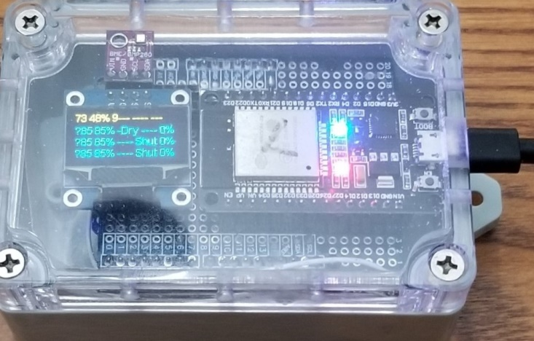
Hub Progression – Oct 2021 Maine

Slide 32
Hub Parts List
Description | Amazon | AliExpress | Notes
MELife 2 Pack for ESP32 ESP-32S Development Board (not Mini!) | $16.99/pair | $1-$3 | Onboard AMD1117 regulator adequate for modem
Botletics SIM7000A LTE CAT-M1 NB-IoT Cellular + GPS + Antenna | $65
Ultronics .96 Inch OLED Module 128x64 SSD 1306 .96” Display | $3 - $10 |  | I2C bus; optional, but convenient during development/debug
BME280 temp/hum sensor | $15 was $5 | $1.80 | I2C bus;
ELEGOO 3pcs Breadboard 830 Point Solderless Prototype | $9.99/3 |  | OR: Prototype PCB for Arduino R3 Shield Board DIY $8.90/4
Breadboard jumper wires | $10/kit |  | Precut sizes, convenient
BN-LINK 7 Day Heavy Duty Digital Programmable Timer | $13.99 |  | Battery backup timer

Slide 33
Hub Parts List 2 – PCB & Enclosure Options
Description | Amazon | Notes
ElectroCookie Solderable Breadboard PCB Double Column | $12.99/3 | PCB having same hole pattern and connections as breadboard!
AwClub Waterproof Dustproof ABS Plastic Junction Box Model 115*90*55 | $6.99 | Use with prototype Arduino shield; transparent cover to view OLED display
OR:
Prototype for Arduino UNO R3 Shield DIY | $8.90/4 | Hole pattern matches Botletics/Arduino
AwClub Waterproof Dustproof ABS Plastic Junction Box Model 100*68*10 | $6.99 | Use with prototype arduino shield; transparent cover to view OLED display
40 pin female header sockets |  | Allows plugging in your compnents instead of soldering
40 pin male breakaway header |  | Plug proto board onto Botletics

Slide 34
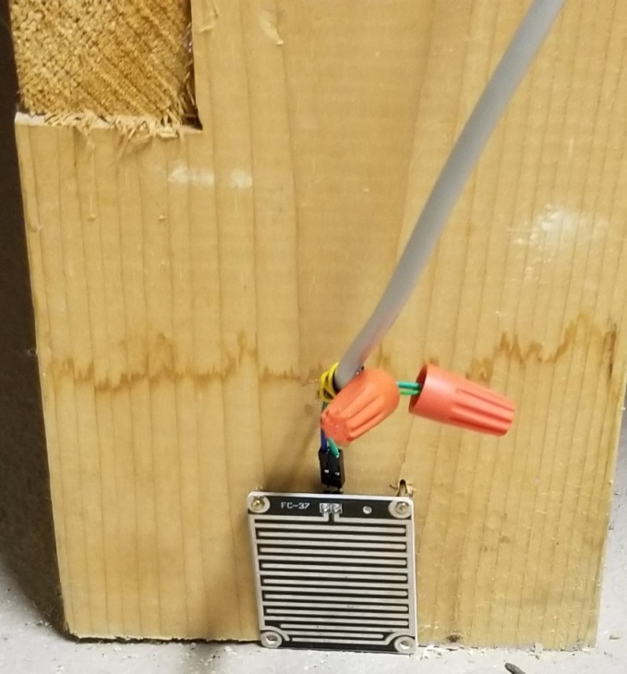
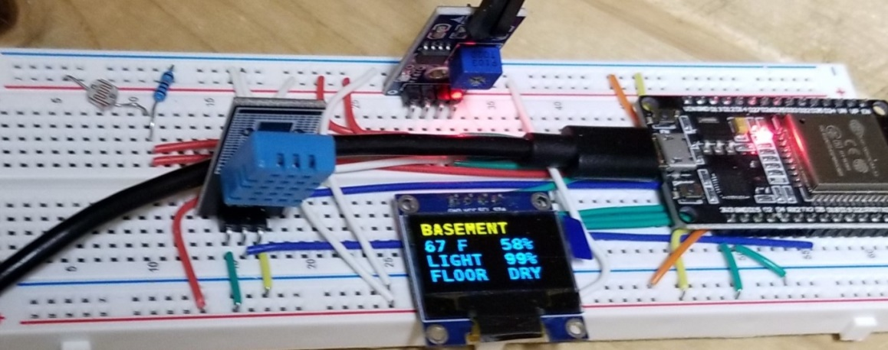

Maine Basement Sensor
(High water mark)

Slide 35
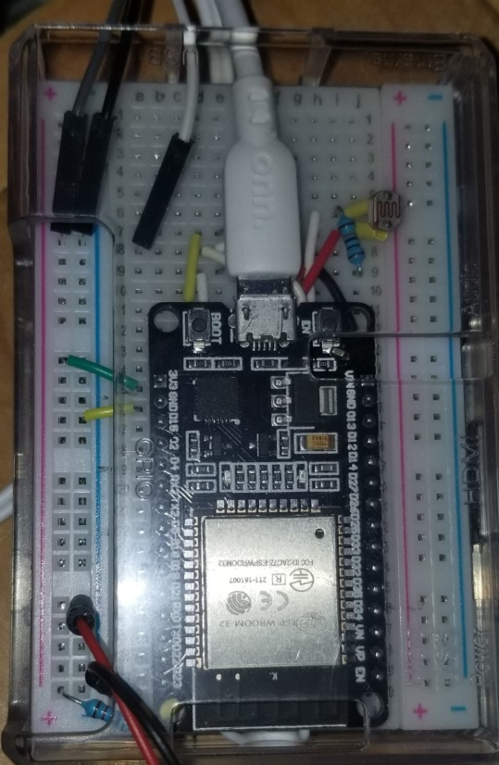
Maine Kitchen Sensor in Rpi case (light, front door, temp)

Slide 36
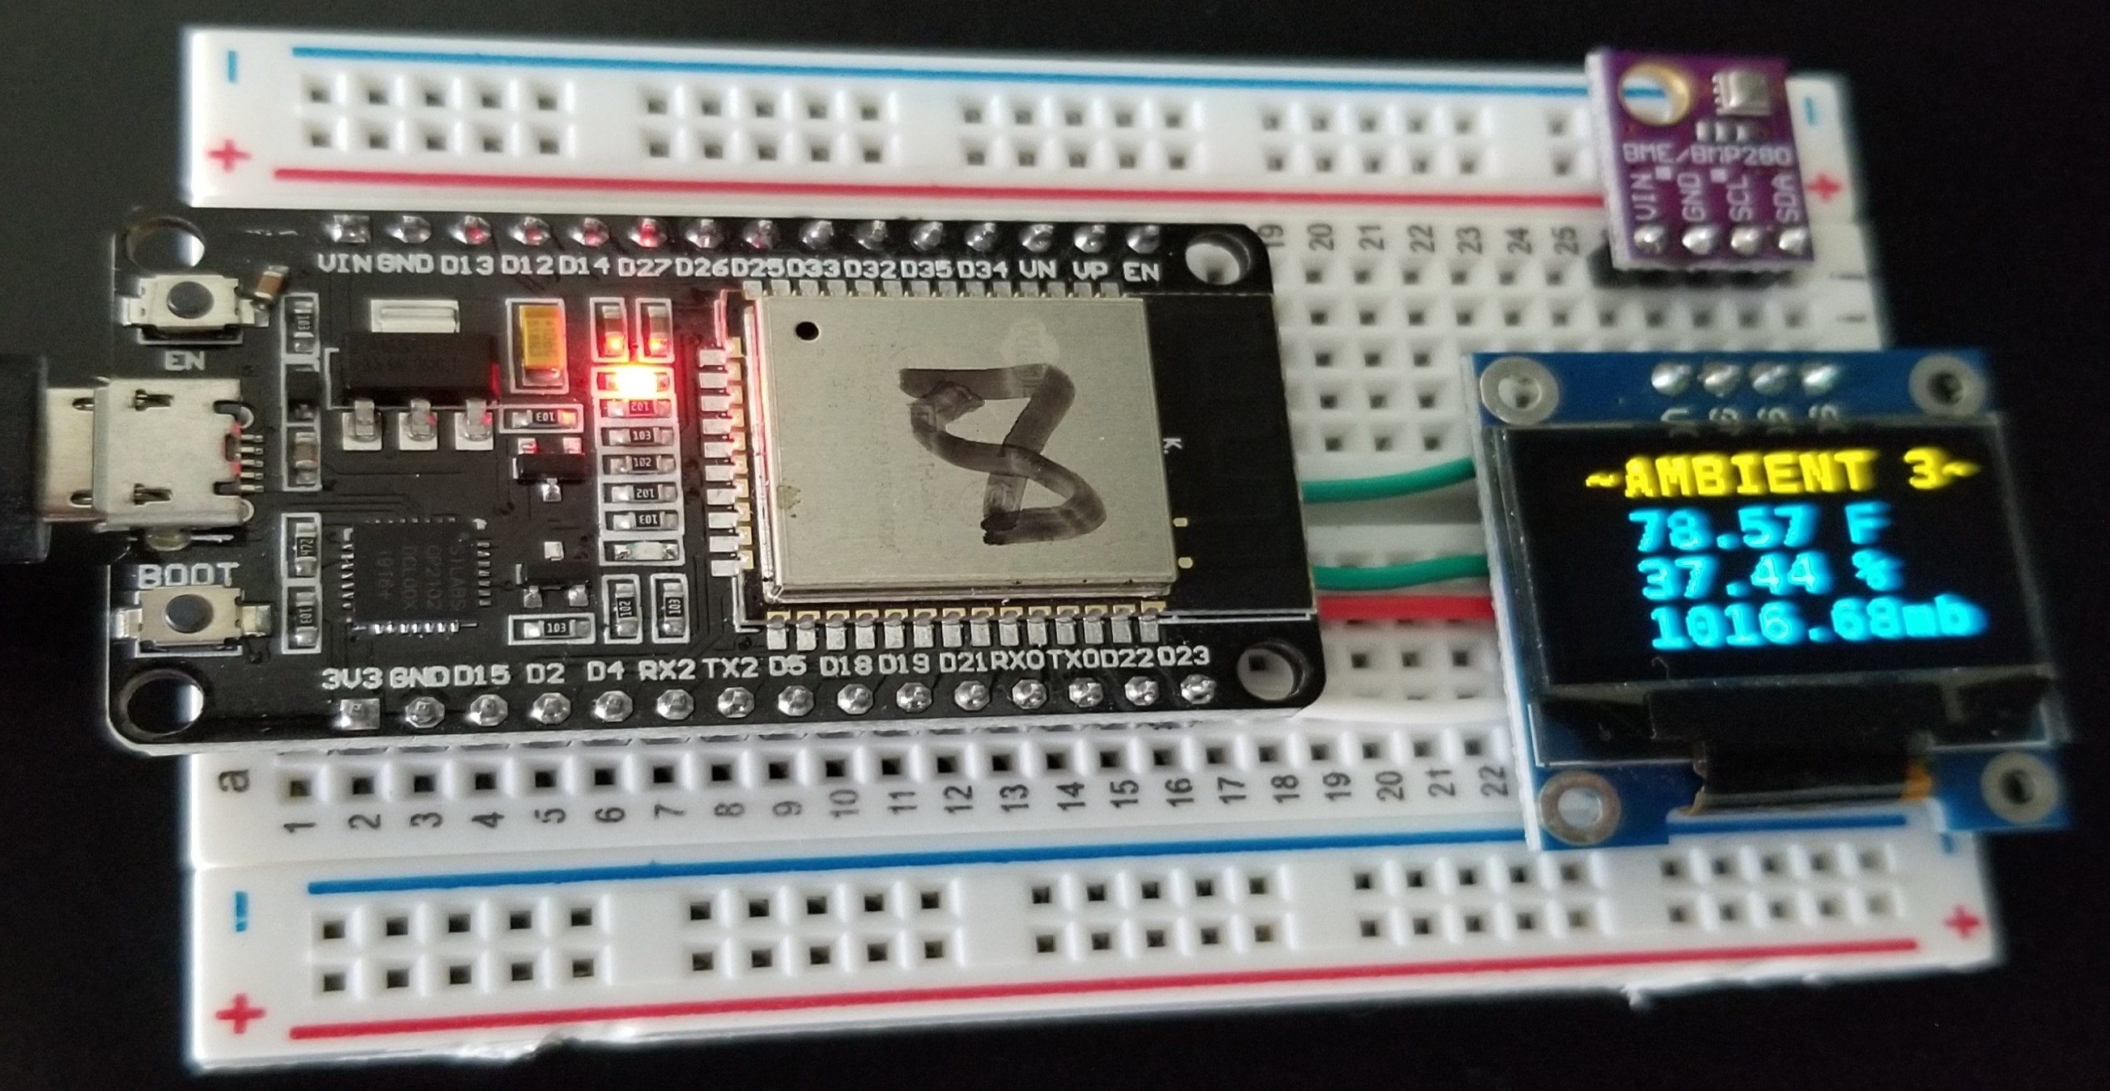
Florida Sensor

Slide 37
Florida Sensor Parts List
Description | Amazon Price | AliExpress + Shipping | Notes
MELife 2 Pack for ESP32 ESP-32S Development Board | 16.99/pair | Less $ | Option: Wemos D1 Mini 8266 (1 only) $3 - $8
Ultronics .96 Inch OLED Module 128x64 SSD 1306 .96” Display | $3 - $10 | Less $ | I2C bus; optional, convenient
BME280 temp/hum sensor | $15 | $1.80 | I2C bus
ELEGOO Breadboard 415 Point Solderless Prototype
Option: ATPWONZ Plastic Boxes | $14.99/10 |  | Enclosure encompasses breadboard. Drill ventilation holes.

Slide 38
Software – Instructions that tell a computer what to do

Slide 39
Software & Services
Description | Base Cost | Source | Why is Necessary
Hologram.io Service | $0 | Google it | Cellular access, ioT SIM card
IFTTT.com Service | $0 for up to 5 applets | Google it | Pass data to gmail, populate google sheets
Dweet.io Service | $0 | Google it | IFTTT backup
Arduino IDE Software | $0 | Google it | Edit & Load ESPxx sketch
AmbientHUB Software | $0 | H.O.T 2/22/2022 | Hub Software
AmbientAP Software | $0 | H.O.T 2/22/2022 | Optional Sensor Software
Arduino Libraries (listed as #include in Ambient software) | $0 | Import using IDE | Building blocks for Ambient software
Google Drive, Sheets, Gmail | $0 | Google | Dedicated email, analysis

Slide 40
Options – Alert Mode or Snooze Mode
Alert Mode responds immediately
HUB stays awake, polling sensors
Sensors can stay awake or sleep until interrupt event
HUB uploads hourly heartbeat data as well
Requires temperature sensors outside case

Slide 41
Options – Alert Mode or Snooze Mode
Snooze Mode simply sends data Hourly
HUB sleeps 48 minutes, wakes 12 minutes
Sensors sleep 8 minutes, wake 2 minutes
HUB can read all 3 sensors while awake
Enables internal temperature sensors to stay cool

Slide 42
Ambient_AP Sensor Software
Compile-time options are explained in the top section
Setup()
reads sensors & starts AP to respond to http requests
Loop() execution
If snooze mode, do nothing until its time to go to sleep
Else
Read sensors at timed intervals
Repeat Loop()

Slide 43
Ambient_HUB Software
Compile-time options are explained in the top section
Setup()
initialize hardware
Loop() execution
Reads sensors when & sends an event to IFTTT immediately if alarmMode = 1
Heartbeat data is sent to IFTTT or Dweet.io each hour
If Snooze Mode, Sleeps 48 minutes after which time setup is run again before repeating Loop() for 12 minutes

Slide 44
Troubleshooting Tips - Local
Interpret OLED displays and LED blink rates
Embedded Print Statements to status monitor in test mode
EN button on ESP’s reboot system tests entire loop on startup
Misc software flags can be adjusted to diagnose issues

Slide 45
To Do List - Software
AT commands to eliminate the fona library, reduce 1.3k / msg
Evaluate the 1.5-in Global.com unit to reduce the size and cost
Ordered one Jan 9, 2022; it arrived Jan 24 from AliExpress
MQTT using online broker?
Evaluate ESP Now for sensor-hub communication

Slide 46

The Devil is in the Details
Where’s the beef?!
Moving on . .

Slide 47
What Exactly IS this Project?
Sensors monitor ambient conditions in empty home x 2
Sensors are hard wired – no batteries
It is NOT a security system
It is NOT FCC approved for resale (FCC 47 cfr 2.803)

Slide 48
Alphabet Soup – Cellular Terms
Cellphones sell access by the GigaByte ($2/GB)
3G GSM – Global System for Mobiles (AT&T, T-Mobile)
3G CDMA – Code Division Multiple Access (Verizon, Sprint)
4G HSPA – High Speed Packet Access = faster version of 3G GSM
“4G” LTE – Long Term Evolution – Verizon, fast data performance technology designed with an eye on 5G; 4G LTE speed = 3G x 10
5G – 4G LTE x 100 (download a 2-hr movie in < 10 seconds)

Slide 49
Alphabet Soup – Cellular Terms
ioT sells access by the Mbyte (1$/MB) x 1000 = $1000/GB
NB-IoT – 200 kHz BW 30/60 DnLd/UpLd kbps, 35km range
LTE-M – 1.4 MHz BW 300/375 DnLd/UpLd, 15-20 km range
Simcom LTE-M/NB-IoT Modems – SIM7000A,C,E,G
America, China, Europe, Global

Slide 50
Sensor Wiring (ESP32)
All labels are as printed on ckt board, not schematic pins!
Function is in ()
External power is supplied to the ESP32 via USB cable
ESP32 3.3 volt pin supplies power to all components
ESP32 Micro Controller
BME280 Temp Humidity Sensor
OLED DISPLAY
D22(SCL)
D21(SDA)
GND
3.3v
SCL
SDA
GND
Vcc
SCL
SDA
GND
Vcc

Slide 51
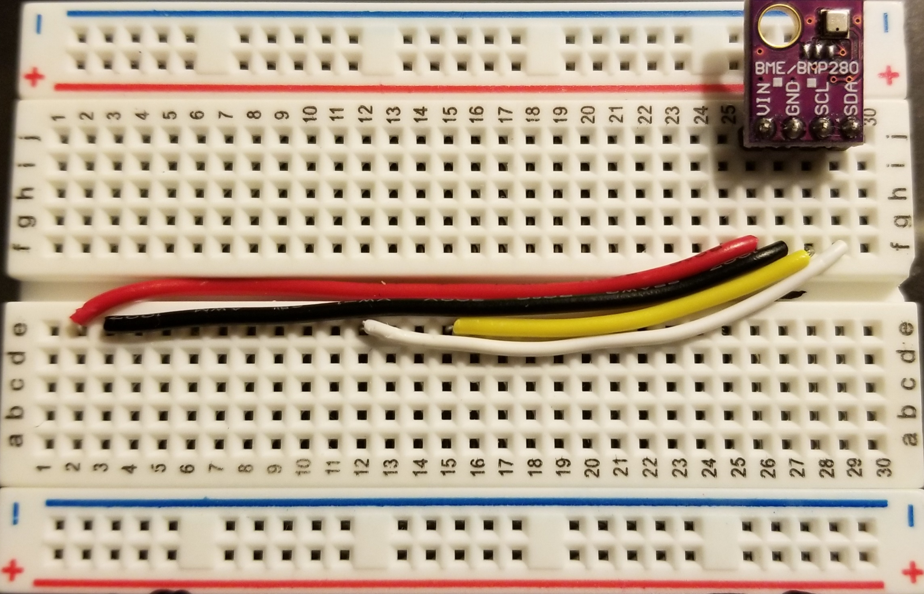
ESP32 Temp Sensor / OLED Wiring

Slide 52
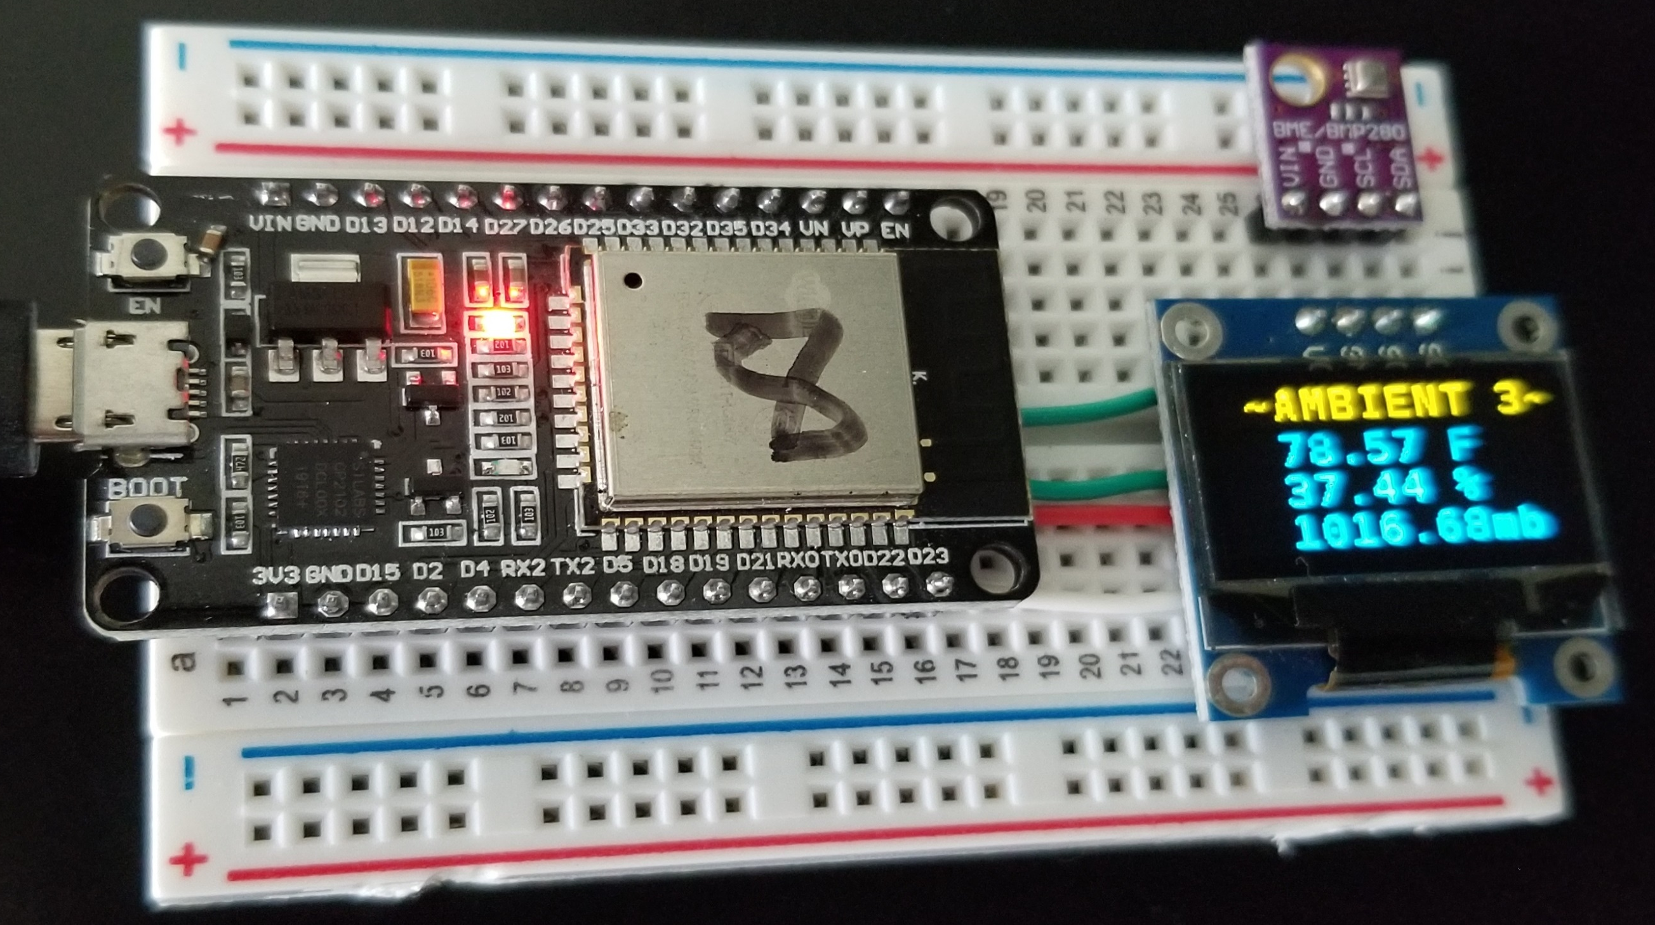
ESP32 / Temp Sensor / OLED Placement

Slide 53
Sensor Wiring (Wemos D1 Mini)
All labels are as printed on ckt board, not schematic pins!
Function is in ()
External power is supplied to the D1 Mini via USB cable
ESP32 3.3 volt pin supplies power to all components
D1Mini 8266
BME280
OLED DISP
D1(SCL)
D2(SDA)
GND
3.3v
SCL
SDA
GND
Vcc
SCL
SDA
GND
Vcc

Slide 54
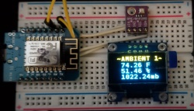
D1 Mini Example – Jumper cable to wake up

Slide 55
Botletics Shield Properties - Arduino
Botletics Shield has 2 voltage inputs
LiPo Battery to meet surge current requirements for SIM7000A Radio
Surge current can be up to .6A LTE-M or up to 2A NB-IoT
5 volt line charges LiPo battery and provides logic voltage
Botletics Shield
Level Shifter
5v Rx, Tx, Pwr pulse
1.8v Rx, Tx, Pwr Modem
Arduino
SIM7000A
5v Out
5v In
1.8v
Charger
(3 - 4.3v)
3.7v LIPO 1200 mAh Battery 3.4-4.3v
VBAT
VBAT 3.7v Radio

Slide 56
Botletics – Workaround 1
Replace the Arduino, dump the battery, and use the LTE-M band
A dedicated 3.3v .8A regulator handles SIM7000A radio
ESP32 3.3v feeds into shield 5v In to the level shifter
Botletics Shield
Level Shifter
3.3v Rx, Tx, Pwr pulse
1.8v Rx, Tx, Pwr Modem
ESP32
SIM7000A
3.3v
5v In
1.8v
Charger
(3 - 4.3v)
Wall Wart
xxx1117 3.3v Regulator
VBAT
VBAT 3.7v Radio

Slide 57
Botletics – Workaround 2
Route The ESP32 3.3v to the battery input
Verify your ESP32 uses a LM1117 or AMS1117 or equivalent regulator
Botletics Shield
Level Shifter
3.3v Rx, Tx, Pwr pulse
1.8v Rx, Tx, Pwr Modem
ESP32
SIM7000A
3.3v Out
5v In
1.8v
Charger
VBAT
VBAT 3.7v Radio

Slide 58
Hub Wiring (ESP32)
ESP32 3.3 volt pin supplies power to all components
Connect Botletics 5V to VBAT
Add 3 wires: Rx, Tx, Power + I2C temperature sensor option
ESP32
BME280
OLED DISP
BOTLETICS ARDUINO SHIELD
D22(SCL)
D21(SDA)
GND
3.3v
D16(Tx2)
D17(RX2)
D18
SCL
SDA
GND
Vcc
SCL
SDA
GND
Vcc
SCL
SDA
GND
5V
VBAT
11 (RX2)
10 (TX2)
7 (Pwr)
MCP9808

Slide 59
Ambient_HUB Power Issue
Botletics Power On/Off can get out of sync with ESP32
Pulse width determines power state; 72ms pulse ON; 1.2 sec OFF
Condo living comes with noisy electromagnetic effects
Occasional hangup is cured by timer to reboot Hub
ESP32
BME280
OLED DISP
BOTLETICS
D22(SCL)
D21(SDA)
GND
3.3v
D16(Tx2)
D17(RX2)
D18
SCL
SDA
GND
Vcc
SCL
SDA
GND
Vcc
SCL
SDA
GND
5V
VBAT
11 (RX2)
10 (TX2)
7 (Pwr)

Slide 60
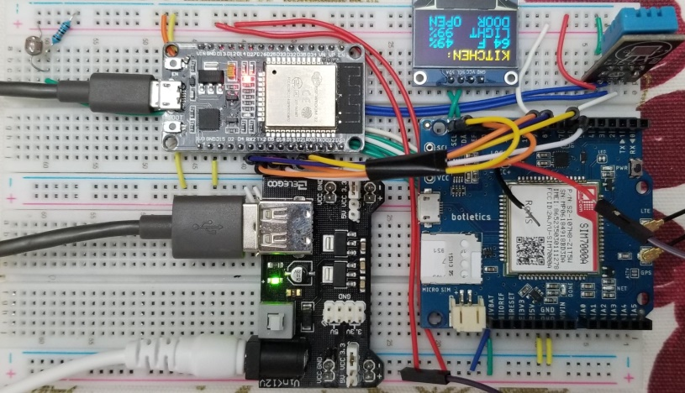
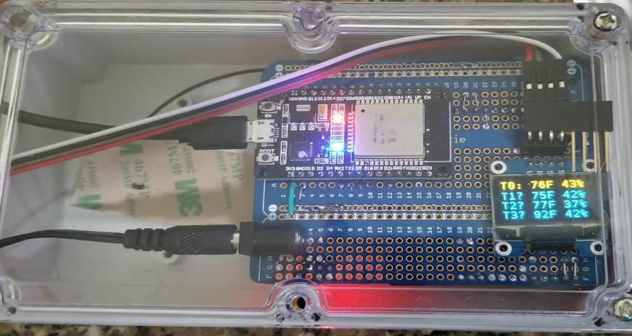
Hub Progression
Oct 2020 Maine
May 2021 Florida 4.5x3.5x2”
Oct 2021 Maine 4x2.7x1.5”
Breadboard
Botletics powered separately
DHT11 temp sensor
OLED display
Alert Mode
Optical sensor
Double wired
ElectroCookie PCB shield
Botletics powered separately
External BME280 temp sensor
OLED display
Alert Mode
Arduino PCB shield
Botletics powered by ESP32
Internal BME280 temp sensor
OLED display
Snooze Mode
Ventilation holes drilled in case

Slide 61
Hub Progression - Oct 2020 Maine

Slide 62
Hub Progression – May 2021 Florida

Slide 63
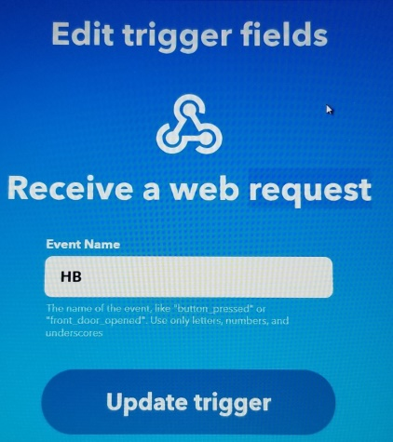
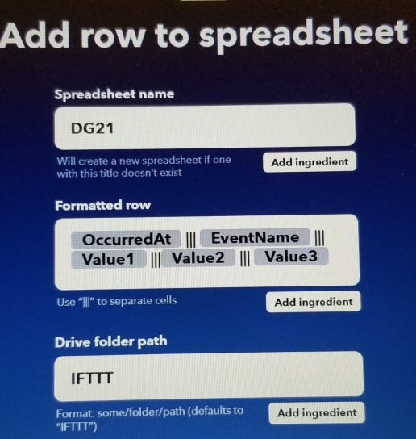
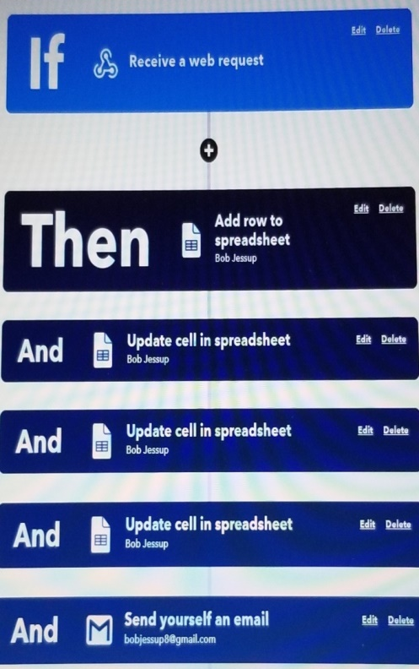
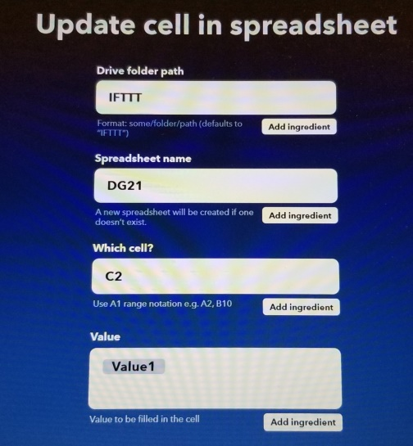
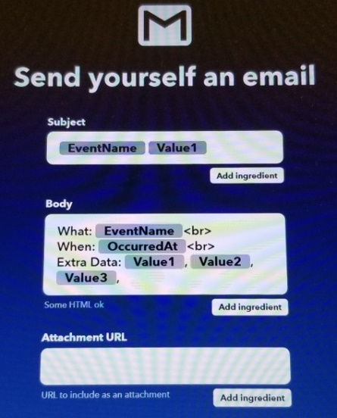
IFTTT Event Applet Ingredients
Cells A2, B2, and C2 are updated with date time, Web event name (HB for heartbeat or AL for ALERT), and the JSON Value1 so that Home Assistant can be used to monitor those cells instead of chasing after the newest row.

Slide 64
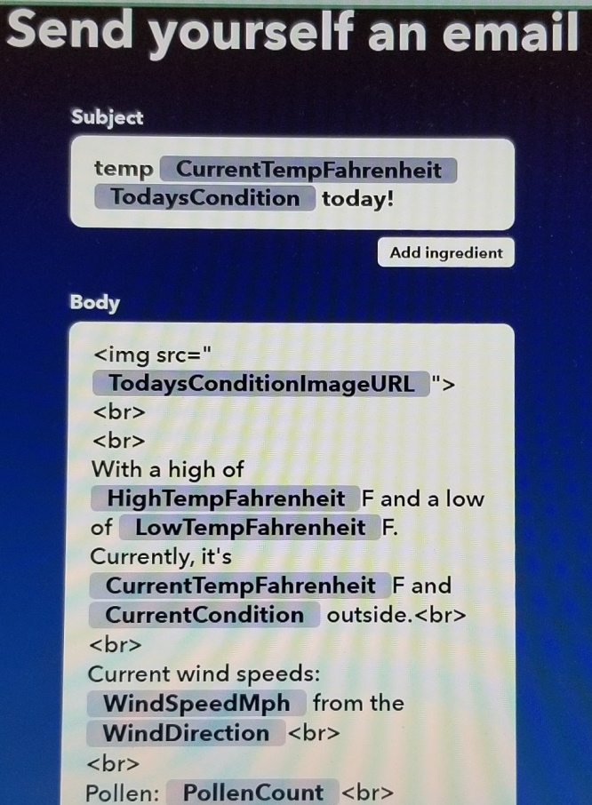
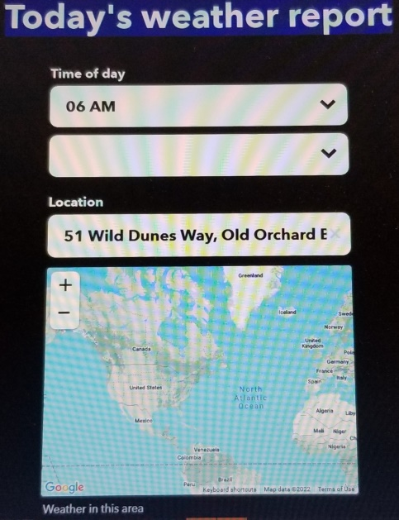
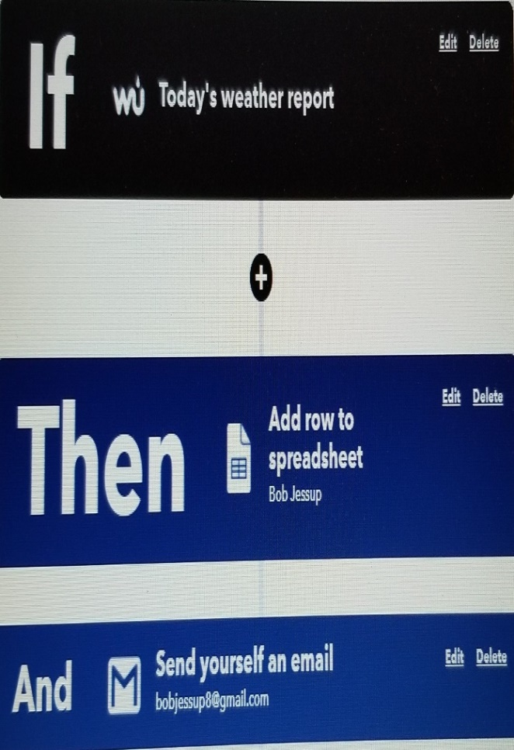
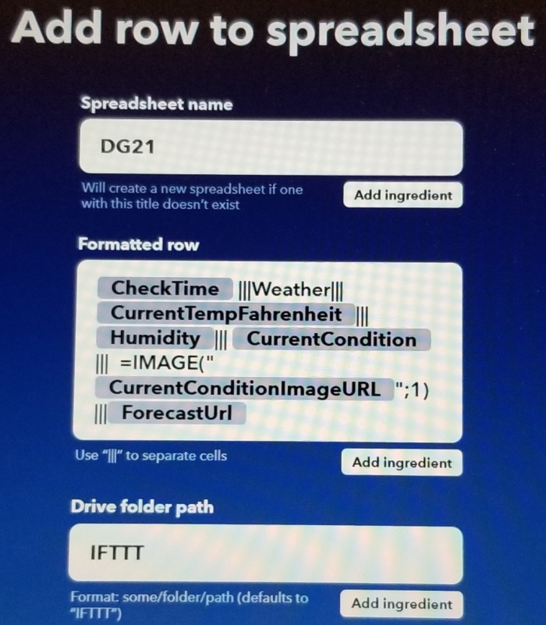
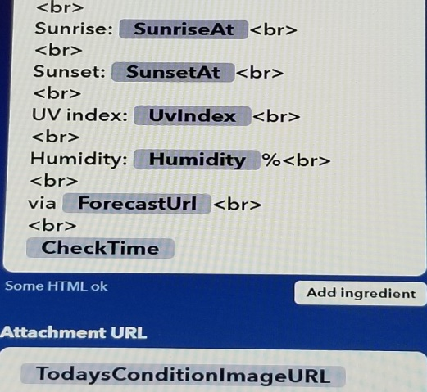
IFTTT Weather Applet Ingredients

Slide 65

Ambient_AP Software Parameters
In the first section at the top of the software:
Comment one of the following lines (//) to select processor
#define ESP32
// #define ESP8266 (commented by default)
Choose between alert mode or Snooze mode (default)
const int sleepSeconds = 8*60; //sleep time in seconds (default)
// 0 if no sleep (alert mode)
const long awakeSeconds = 2*60; //interval in seconds to stay //awake as server;
If sleepSeconds is set to 0, awakeSeconds is ignored

Slide 66

Ambient_AP Software Parameters
Each sensor needs unique display title and ssid; uncomment one triplet and comment the others before compiling
//uint8_t sensorID = 1;
//#define displayTitle " ~AMBIENT 1~"
//const char* ssid = "AMBIENT_1";
uint8_t sensorID = 2;
#define displayTitle " ~AMBIENT 2~"
const char* ssid = "AMBIENT_2";
//uint8_t sensorID = 3;
//#define displayTitle " ~AMBIENT 3~"
//const char* ssid = "AMBIENT_3";

Slide 67
Ambient_HUB Software Parameters
Enter your IFTTT key in place of ENTER_KEY
#define IFTTT_HB_URL "http://maker.ifttt.com/trigger/HB/with/key/ENTER_KEY"
Choose between alert mode or snooze mode (default)
const int espSleepSeconds = 48*60; //sleep time in seconds (default)
// 0 if no sleep (alert mode)
const long espAwakeSeconds = 12*60; // interval in seconds to stay //awake as HUB;
If espSleepSeconds is set to 0 (alert mode), espAwakeSeconds is ignored

Slide 68
Gotcha’s – A Consolidated List
Voltage to the Botletics pin cannot drop below 3.0v while current could spike to 600 ma during connection and data transfer on LTE-M; 2A on NB-IoT
Software selects LTE-M band
LIPO batteries built for toys have different polarity than those built for electronics??; doublecheck your battery polarity if you use one
WEMOS D1 Mini (esp8266) can have inadequate rf range, possible wifi library issues, and interfere with each other if >1?
Verify regulators on ESP32’s! Need xx1117 or equivalent to handle LTE-M
SIM sockets can be tinny, easily bent – Handle with care!
Put a timer with battery backup to reset the hub periodically!

Slide 69
Hologram: Cellular Connectivity to the Cloud
Dashboard for deployed device management and control
Data can be massaged and routed to other services
Messages can be sent to devices from the dashboard
Individual sensors can be analyzed
For example: the next slide reveals that IFTTT may be throttling by refusing data periodically
OR
It might be a software issue to test on my duplicate system

Slide 70
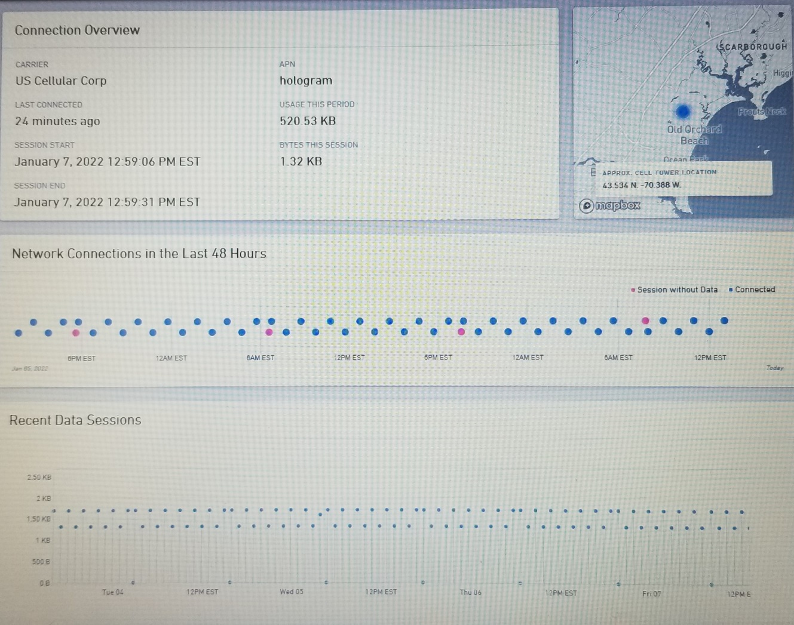
Hologram Dashboard Provides Connection Details
Connection Overview
Network Connections in the Last 48 Hours
Recent Data Sessions

Slide 71
References

Slide 72
References
Paul McWhorter Arduino
A series of YouTube videos which show you how to install the IDE and get started programming the Arduino microcontroller
Random Nerd Tutorials
Step by step instructions explaining various arduino-based esp32 and esp8266 microcontrollers, projects, protocols, and much more. They include plenty of working project code

Slide 73
References
The Guy with the Swiss Accent
Hands on Tech The Villages Florida
See H.O.T meeting 11/30/2017 and on-ramp material for detailed steps to set up IFTTT account and the Arduino IDE
Botletics Wiki, Botletics GitHub

Slide 74
FCC Notice (47 CFR 2.803)
The following notice accompanys the Botletics shield:
“This kit is designed to allow:
(1) Product developers to evaluate electronic components, circuitry, or software associated with the kit to determine whether to incorporate such items in a finished product and…

Slide 75
…FCC Notice (47 CFR 2.803) para 2
…(2) Software developers to write software applications for use with the end product. This kit is not a finished product and when assembled may not be resold or otherwise marketed unless all required FCC equipment authorizations are first obtained. Operation is subject to the condition that this product not cause harmful interference to licensed radio stations and that this product accept harmful interference. Unless the assembled kit is designed to operate under part 15, part 18 or part 95 of this chapter, the operator of the kit must operate under the authority of an FCC license holder or must secure an experimental authorization under part 5 of this chapter.”

